Slide 1

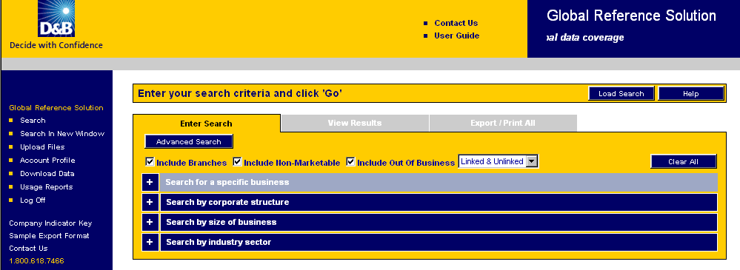
Dun & Bradstreet - Getting Started with GRS
Click & save on the following link: https://solutions.dnb.com/usgrs/
Enter your User ID*
Enter your Password*
Click LOG ON
You are launched into the tab to Enter Search ~ Search for a Specific Business
You can also search by Corporate Structure, Size of Business, or Industry Sectors
by clicking on +/- button on left which will expand or collapse sections
There are 42 fields available for selection – you can choose as many or few as required
Note at the top the default is to include Branches, Non-Marketable and Out of Business Records.
Once you’ve entered all your information click GO
Your search Results are the very top – Total Matches = xxx
Click the View Results tab to see the list of companies that match your search criteria
There are 8 data elements displayed. This can help you to determine the best match. You can click Custom List to change the 8 fields displayed.
Click on the Company Name hyperlink to get the GRS Company Detail Report.
There are tabs at the top to View the Family Tree or the Credit Report button for the full D&B detailed report.
To EXPORT results, click on Export/Print All tab to output a report or family tree details.
Select product by using the drop down menu which provides different formats (HTML, PDF, EXL, CSV) for reports and/or family tree ouptut
Select the quantity (NOTE: you can only print or export 10,000 results at one time)
Click order, name your export for reference
Once complete - go to Download Data in left navigation bar for results (depending on size of request, it may take a few minutes)
All reports are saved for 28 days
*Shortcut to print (ctrl/p) and save (ctrl/s)
Additional hints… Before you begin new search, click on Clear Section or Clear All buttons
To use forward/back button functionality – use ALT key with the forward/back arrow keys
Be sure to LOGOFF EACH SESSION or else you won’t be able to log back in until you get your ID and pass code reset. LOG OFF button is located in left navigation bar
If you have trouble getting started or have questions, call 1 800.618.7466

